Slide 1
Machine Learning -Modeling
Theory and Practice

Slide 2
Agenda
Overview
Introduction to Modeling
Supervised vs Unsupervised
Data Insights and Discovery
Hands-on exercise (Part 1):
Predictive vs Prescriptive Modeling
Optimization and Feedback loops in Modeling
Hands-on exercise (Part 2):
Model LifeCycle (MLOps)
Machine Learning vs Deep Learning
Hands-on exercise (Part 3):

Slide 3
Advanced ML Concepts
Application of ML Models
ML and AI Making big moves in Marketing and Finance Analytics
EDA : Success, Insights and Lessons
Regression Analysis : Discovery
Ways of Bayes : Classification , K-means, Decision Trees
Forecasting - as- service (Real-time Application)
ML Algorithms to Business Problems
Key learnings for Data Scientist Career / ML Engineer
Hands-on Project

Slide 4
Before we begin ….
Algorithm: Set of rules to follow to solve a problem (Security camera , thermostat controls)
Machine Learning: Algorithms to learn from experience (previous) - Supervised and Pattern recognition (unsupervised)
AI : Humans intelligence in machines to take certain actions based on data(Chatbots/ agents/robots)
Data Science: Scientific method to discover from Data (EDA/Stats/Viz , Modeling ..)
Analytics: Products associated to DS and ML (Finance Analytics,Predictive Analytics,Sales Analytics, Marketing decision , Cyber Security Analytics)

Slide 5
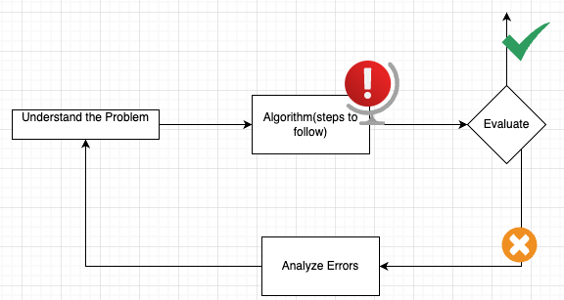
Overview : Why we use Machine Learning ?

Slide 6
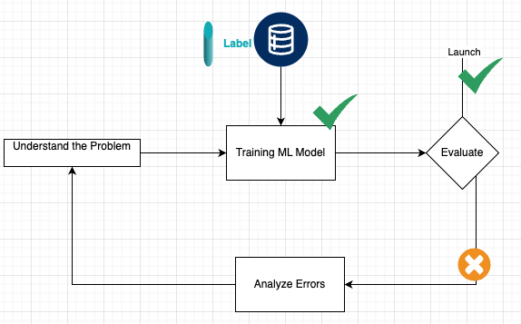
Machine Learning Way of doing …
1. Understand the Problem
Define the goal, success metrics, and data needs.
2. Label / Prepare Data
Collect, clean, and label data for training.
3. Train ML Model
Choose algorithm, train on labeled data, and tune parameters.
4. Evaluate
Test model on unseen data and measure performance.
5. Analyze Errors
Find causes of poor performance and identify improvements.
6. Feedback Loop
Iterate between understanding, training, and analysis to refine the model.
7.Launch
Deploy the model once performance meets requirements.

Slide 7
Scientific Method of ML Modeling
Scientific Method | ML Process
Ask a Question → | Understand the Problem
Form a Hypothesis → | Choose a Model
Experiment → | Train the Model
Analyze Results → | Evaluate Performance
Revise → | Improve and Retrain
Machine learning follows the same logic as the scientific method — we ask questions, test ideas using data, analyze results, and improve based on evidence.

